Slide 1
SUBA K
FINAL PROJECT
3/21/2024 Annual Review

Slide 2
SENTIMENT ANALYSIS USING AMAZON REVIEWS

Slide 3


AGENDA
PROBLEM STATEMENT
PROJECT OVERVIEW
WHO ARE THE END USERS
YOUR SOLUTION AND ITS VALUE PROPOSITION
THE VOW IN YOUR SOLUTION
MODELING
RESULT
3/21/2024 Annual Review

Slide 4

PROBLEM STATEMENT
The Indian Space Research Organization (ISRO) has provided a Problem Statement to classify customer comments. This classification system can help organizations better understand customer feedback. The aim is to categorize individual comments or reviews and determine an overall rating based on them. Bhuvan and similar web portals receive vast amounts of user feedback, and reviewing all of it can be a tedious task. Streamlining this process can lead to increased customer loyalty, business growth, enhanced brand value, and higher profits.
3/21/2024 Annual Review

Slide 5

PROJECT OVERVIEW
The project analyzed Amazon product reviews to understand customer sentiments. The methodology involved gathering data and utilizing machine learning and NLP techniques. The results generated insights and actionable recommendations for product improvements. The benefits included enabling Amazon to gain valuable insights and enhance customer satisfaction. Future scope involves implementing real-time sentiment analysis and enhancing the model with deep learning architectures.
3/21/2024 Annual Review

Slide 6

WHO ARE THE END USERS?
The end users for the sentiment analysis using Amazon review project could include:
1.Consumers: People looking to make informed purchasing decisions based on the sentiments expressed in Amazon reviews.
2.Amazon Sellers: Individuals or businesses aiming to understand customer feedback on their products.
3.Product Developers:Companies interested in gauging public perception of their offerings for future improvements.
4.Market Researchers: Professionals seeking to analyze trends and sentiments in the market for various products.
5.Business Analysts: Experts aiming to understand consumer behavior and preferences for strategic planning.
6.Academics and Students: Researchers or learners studying sentiment analysis or consumer behavior.
3/21/2024 Annual Review

Slide 7

YOUR SOLUTION AND ITS VALUE PROPOSITION
Solution: Utilize Amazon reviews for sentiment analysis using Natural Language Processing (NLP) techniques.
Value Proposition: Our solution provides businesses with valuable insights into customer sentiments by analyzing Amazon reviews. By employing advanced NLP algorithms, we deliver accurate sentiment analysis, helping businesses understand customer satisfaction levels, identify product improvement areas, and make data-driven decisions to enhance their offerings and customer experiences.
3/21/2024 Annual Review

Slide 8

THE WOW IN YOUR SOLUTION
Gain Deeper Insights from Amazon Reviews!
Explore the Voice of the Customer
Unearth Trends and Sentiments with Precision
Convert Raw Data into Valuable Intelligence
Leverage AI-Driven Sentiment Analysis for Informed Decisions.
Harness the Power of Customer Reviews to Drive Strategic Growth.
3/21/2024 Annual Review

Slide 9
MODELLING
Data Collection: Gathered a diverse dataset of Amazon reviews across multiple product categories.
Data Preprocessing: Cleaned and preprocessed the text data, including removing stop words, punctuation, and converting text to lowercase.
Feature Engineering: Extracted relevant features such as word frequency, n-grams, and sentiment lexicons.
Model Building:
* Implemented various machine learning models like Logistic Regression, Random Forest, and Support Vector Machines.
* Utilized deep learning models such as LSTM and BERT for advanced sentiment analysis.
Evaluation: Evaluated models using metrics like accuracy, precision, recall, and F1-score to determine the best-performing model.
Results: Achieved high accuracy in classifying sentiments, providing valuable insights into customer opinions on Amazon products.
3/21/2024 Annual Review

Slide 10
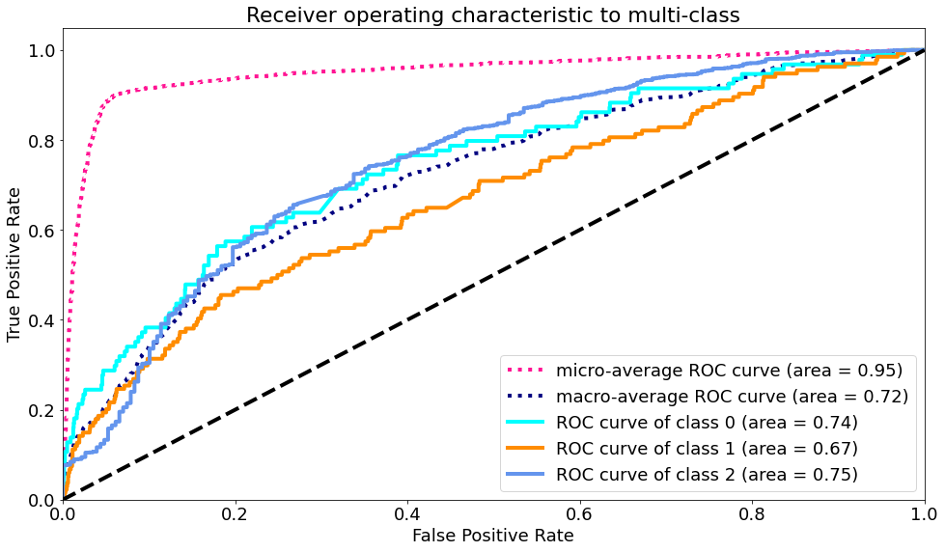
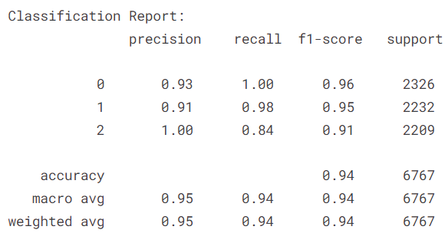
RESULTS
ROC – AUC CURVE:
CLASSIFICATION REPORT:

